Slide 1
Chapter 5: Inter-VLAN Routing
Routing & Switching
Notes:
Cisco Networking Academy program
Routing & Switching
Chapter 5: Inter-VLAN Routing

Slide 2
Chapter 5
5.1 Inter-VLAN Routing Configuration
5.2 Troubleshooting Inter-VLAN Routing
5.3 Layer 3 Switching
5.4 Summary
Notes:
Chapter 5

Slide 3
Chapter 5: Objectives
Describe the three primary options for enabling inter-VLAN routing.
Configure legacy inter-VLAN routing.
Configure router-on-a-stick inter-VLAN routing.
Troubleshoot common inter-VLAN configuration issues.
Troubleshoot common IP addressing issues in an inter-VLAN-routed environment.
Explain advantages of Layer 3 switching.
Notes:
Chapter 5 Objectives

Slide 4
5.1 Inter-VLAN Routing Configuration
Notes:
Cisco Networking Academy program
Routing & Switching
Chapter 5: Inter-VLAN Routing

Slide 5
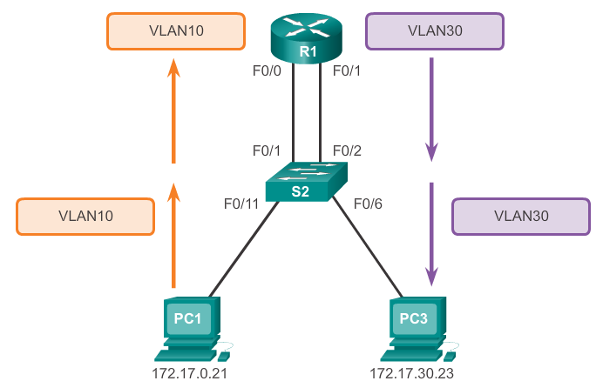
Inter-VLAN Routing Operation
What is Inter-VLAN routing?
Layer 2 switches cannot forward traffic between VLANs (different subnets).
To route traffic between different VLANs, a router is required.
Inter-VLAN routing is the process to forward network traffic from one VLAN to another, using a router.
Question:
Where is the default gateway for
PC1?
PC3?
Notes:
5.1.1.1 What is Inter-VLAN routing?

Slide 6
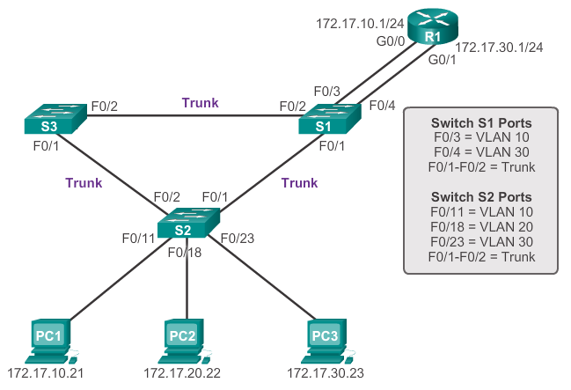
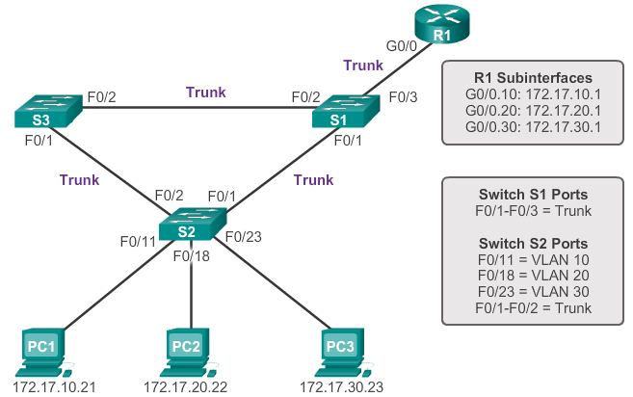
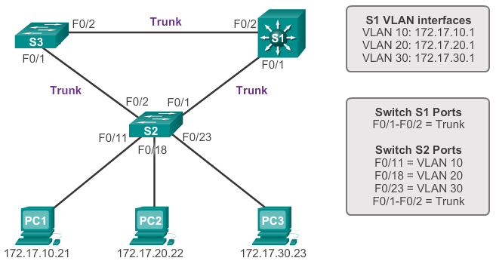
Inter-VLAN Routing Operation
Inter-VLAN Routing Options
(1)
(2)
Legacy
Router-on-a-Stick
Multilayer switch
(3)
See NetAcad 5.1
Notes:
5.1.1.2 Legacy Inter-VLAN Routing

Slide 7
Inter-VLAN Routing Operation
Legacy Inter-VLAN Routing
Previously, routers with many multiple interfaces were used to route traffic between VLANs.
Each VLAN connects to a different router physical interface.
Packets arriving at the router through one interface for that VLAN, is routed and leave through another interface for the other VLAN.
Question
Large networks with many VLANs. Is this method feasible??
Notes:
5.1.1.2 Legacy Inter-VLAN Routing

Slide 8
Configure Legacy Inter-VLAN Routing
Legacy Inter-VLAN Routing Config
Legacy inter-VLAN routing requires routers to have multiple physical interfaces.
Each one of the router’s physical interfaces is connected to a unique VLAN.
Each interface is also configured with an IP address for the subnet associated with the particular VLAN.
The switch port is configured as an ACCESS port for that VLAN.
End devices use the router interface IP address for that VLAN as the Default Gateway.
Notes:
5.1.2.1 Configure Legacy Inter-VLAN Routing: Preparation

Slide 9
Inter-VLAN Routing Operation
Multilayer Switch Inter-VLAN Routing
Switches are typically Layer 2 network devices, thus supporting only Layer 2 functions.
Multilayer switches support both Layer 2 and Layer 3 functions, replacing the need for dedicated routers.
A multilayer switch understands network-layer PDUs; acting like a router routing packets between its interfaces.
Thus multilayer switches also support dynamic routing and inter-VLAN routing.
A multilayer switch routes traffic at hardware speed.
This routing process is a suitable and scalable solution.
Notes:
5.1.1.4 Multilayer Switch Inter-VLAN Routing

Slide 10
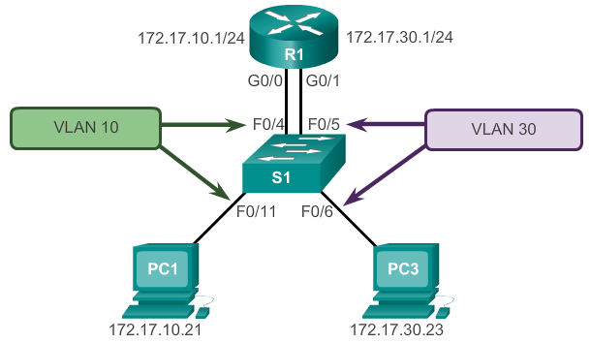
Configure Legacy Inter-VLAN Routing
Legacy Inter-VLAN Routing Config
Access port for VLAN 10
Access port for VLAN 30
Notes:
5.1.2.1 Configure Legacy Inter-VLAN Routing: Preparation

Slide 11
Configure Legacy Inter-VLAN Routing
Switch Configuration
STEP 1: Configure the Switch
Create the VLANs
Configure the ports as ACCESS ports
Configure the ports for that VLAN
S1(config)#vlan 10
S1(config-vlan)#vlan 30
S1(config-vlan)#int range fa0/4,fa0/11
S1(config-if)#switchport mode access
S1(config-if)#switchport access vlan 10
S1(config-if)#int range fa0/5,fa0/6
S1(config-if)#switchport mode access
S1(config-if)#switchport access vlan 30
Question
How to check your configuration?
Notes:
5.1.2.2 Configure Legacy Inter-VLAN Routing: Switch Configuration

Slide 12
Configure Legacy Inter-VLAN Routing
Router Configuration
STEP 2: Configure the Router
Configure the router interfaces with the default gateway IP address for that VLAN
R1(config)#int g0/0
R1(config-if)#ip add 172.17.10.1 255.255.255.0
R1(config-if)#no shutdown
R1(config-if)#int g0/1
R1(config-if)#ip add 172.17.30.1 255.255.255.0
R1(config-if)#no shutdown
Notes:
5.1.2.2 Configure Legacy Inter-VLAN Routing: Switch Configuration

Slide 13
Configure Router-on-a-Stick
Router-on-a-Stick Config
Router-on-a-Stick uses VLAN trunking and subinterfaces.
VLAN trunking allows 1 router physical interface to route traffic for many VLANs.
The router physical interface must be connected to a trunk link on the adjacent switch.
On the router, subinterfaces for each unique VLAN are created on that physical interface.
Each subinterface is then:-
  assigned an IP address specific to that VLAN, and
  configured to tag frames for that VLAN.
Notes:
6.1.3.1 Configure Router-On-A-Stick: Preparation

Slide 14
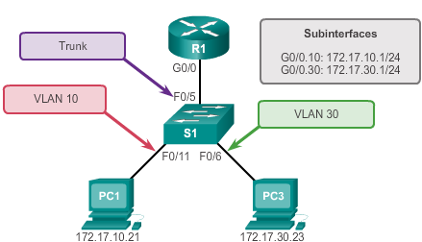
Configure Router-on-a-Stick
Router-on-a-Stick Config
Notes:
6.1.3.2 Configure Router-on-a-Stick: Switch Configuration

Slide 15
Inter-VLAN Routing Operation
Router-on-a-Stick Inter-VLAN Routing
Only one router physical interface is used.
The physical interfaces is configured as a 802.1Q trunk port so that it can understand VLAN tags.
Logical subinterfaces are then created; one subinterface per VLAN.
Each subinterface is configured with an IP address from that VLAN it represents.
VLAN members (hosts) are configured to use the subinterface address as a default gateway.
Notes:
5.1.1.3 Router-on-a-Stick Inter-VLAN Routing

Slide 16
Configure Router-on-a-Stick
Switch Configuration
STEP 1: Configure the Switch
Create the VLANs
Configure the port as a TRUNK port
Add the native VLAN if available
S1(config)#vlan 10
S1(config-vlan)#vlan 30
S1(config-vlan)#int fa0/5
S1(config-if)#switchport mode trunk
S1(config-if)#switchport trunk native vlan vlan-id
Notes:
6.1.3.2 Configure Router-on-a-Stick: Switch Configuration

Slide 17
Configure Router-on-a-Stick
Router Subinterface Configuration
STEP 2: Configure the Router
Create the subinterface using the VLAN ID
Enable encapsulation for that VLAN
Assign the IP address
Repeat for next subinterface until all done
Go to the main interface and enable it
R1(config)#int g0/0.10
R1(config-if)#encapsulation dot1q 10
R1(config-if)#ip add 172.17.10.1 255.255.255.0
R1(config-if)#int g0/0.30
R1(config-if)#encapsulation dot1q 30
R1(config-if)#ip add 172.17.30.1 255.255.255.0
R1(config-if)#int g0/0
R1(config-if)#no shutdown
Notes:
6.1.3.2 Configure Router-on-a-Stick: Switch Configuration

Slide 18
Configure Router-on-a-Stick
Verifying Subinterfaces
To verify your router configuration, use these commands:-
R1# show ip interface brief
R1# show ip route
R1# show running-config
Question
What will you see using the above commands?
Lastly, use an ICMP packet to check that PCs in different VLANs can communicate.
Notes:
6.1.3.4 Configure Router-on-a-Stick: Verifying Subinterfaces

Slide 19
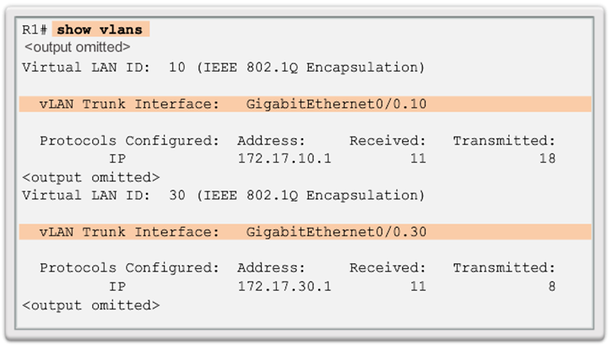
Configure Router-on-a-Stick Inter-VLAN Routing
Configure Router-on-a Stick: Verifying Subinterfaces
Notes:
6.3 – Inter-VLAN Routing Using Routers
6.3.3 – Configure Router-on-a-Stick Inter-VLAN Routing
6.3.3.4 - Configure Router-on-a Stick: Verifying Subinterfaces

Slide 20
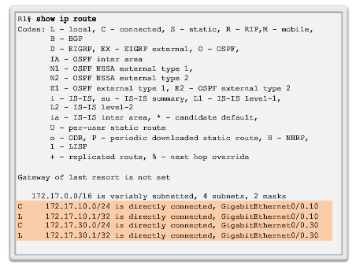
Configure Router-on-a-Stick Inter-VLAN Routing
Configure Router-on-a Stick: Verifying Subinterfaces (cont.)
Notes:
6.3 – Inter-VLAN Routing Using Routers
6.3.2 – Configure Router-on-a-Stick Inter-VLAN Routing
6.3.3.4 - Configure Router-on-a Stick: Verifying Subinterfaces (cont.)

Slide 21
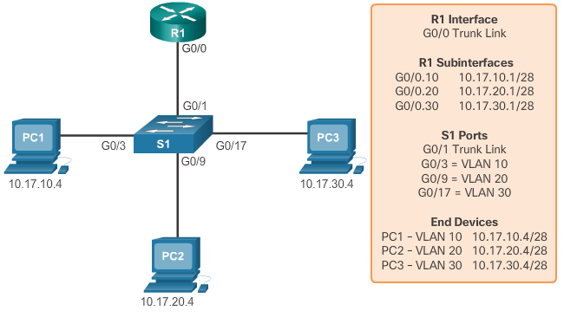
Inter-VLAN Routing Operation
Identify the Types of Inter-VLAN Routing
Activity
Legacy or Router-on-a-Stick?
Notes:
6.3 – Inter-VLAN Routing Using Router
6.3.1 – Inter-VLAN Routing Operation
6.3.1.4 - Identify the Types of Inter-VLAN Routing Activity

Slide 22
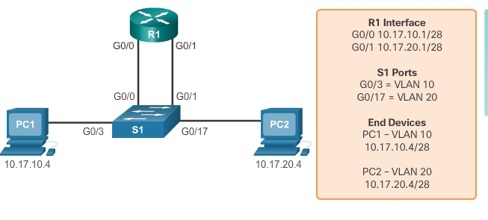
Inter-VLAN Routing Operation
Identify the Types of Inter-VLAN Routing
Activity (cont.)
Legacy or Router-on-a-Stick?
Notes:
6.3 – Inter-VLAN Routing Using Router
6.3.1 – Inter-VLAN Routing Operation
6.3.1.4 - Identify the Types of Inter-VLAN Routing Activity (cont.)

Slide 23
6.2 Troubleshoot Inter-VLAN Routing
Notes:
Cisco Networking Academy program
Routing & Switching
Chapter 5: Inter-VLAN Routing

Slide 24
Inter-VLAN Configuration Issues
Switch Port Issues
Legacy Inter-VLAN routing
Check that the router ports and switch ports are correct.
Check that the switch ports connect to the router interfaces are in ACCESS mode and configured with the correct VLAN.
Use the switchport access vlan [appropriate vlan#] command to correct any erroneous VLAN port assignment.
Router-on-a-Stick Inter-VLAN routing
Check that the router port and switch port is correct.
Check that the switch port is configured as a TRUNK link.
Use the switchport mode trunk command to correct the switch port as a trunk.
Notes:
6.2.1.1 Switch Port Issues

Slide 25
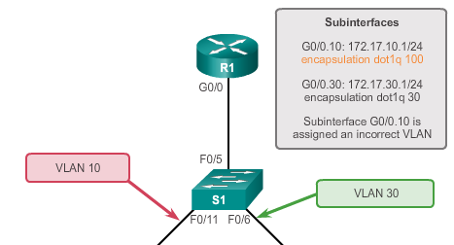
Inter-VLAN Configuration Issues
Router Configuration Issues
With router-on-a-stick configurations, a common problem is assigning the wrong VLAN ID to the subinterface.
The #show interface and #show running-config commands can help detect this problem.
To fix the problem, go to the subinterface and correct using #encapsulation dot1q <vlan_id>.
Notes:
6.2.1.4 Verify Router Configuration

Slide 26
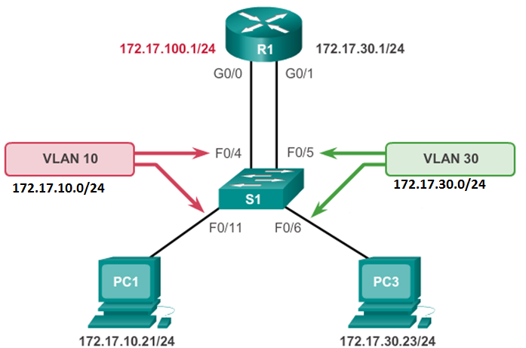
IP Addressing Issues
Errors with IP Address and Subnet Masks
What model is this?
What is wrong?
How to correct?
Notes:
6.2.2.1 Errors with IP Address and Subnet Masks

Slide 27
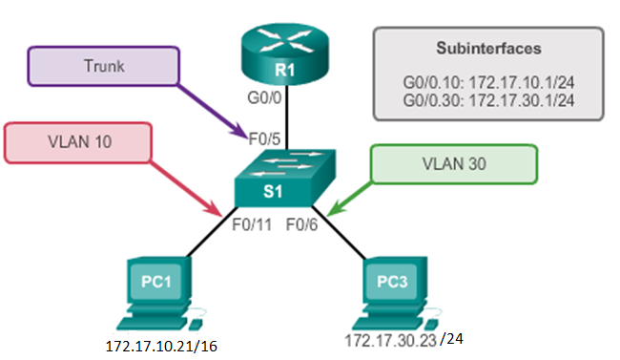
IP Addressing Issues
Errors with IP Address and Subnet Masks
What model is this?
What is wrong?
How to correct?
Notes:
6.2.2.1 Errors with IP Address and Subnet Masks

Slide 28
5.3 Layer 3 Switching
Notes:
Cisco Networking Academy program
Routing & Switching
Chapter 5: Inter-VLAN Routing

Slide 29
Layer 3 Switching Operation and Configuration
Inter-VLAN Routing with Switch Virtual Interfaces
Layer 3 switches have packet-switching throughput in the millions of packets per second (pps) at hardware speed.
Routing can be transferred to core and distribution devices with little to no impact on network performance.
Layer 3 routed ports are normally implemented at the distribution and the core layer. This model is less dependent on spanning tree, because there are no loops in the Layer 2 portion of the topology.
Notes:
5.3.1.2 Inter-VLAN Routing with Switch Virtual Interfaces

Slide 30
Chapter 6: Summary
This chapter described and explained the following concepts:
Inter-VLAN routing, the process of routing traffic between different VLANs, using either a dedicated router or a multilayer switch
Legacy, router-on-a-stick, and multilayer switch inter-VLAN routing
Common errors involving VLAN, access or trunk and IP addressing issues
Troubleshooting inter-VLAN routing
Notes:
Chapter 5 Summary

